Slide 1
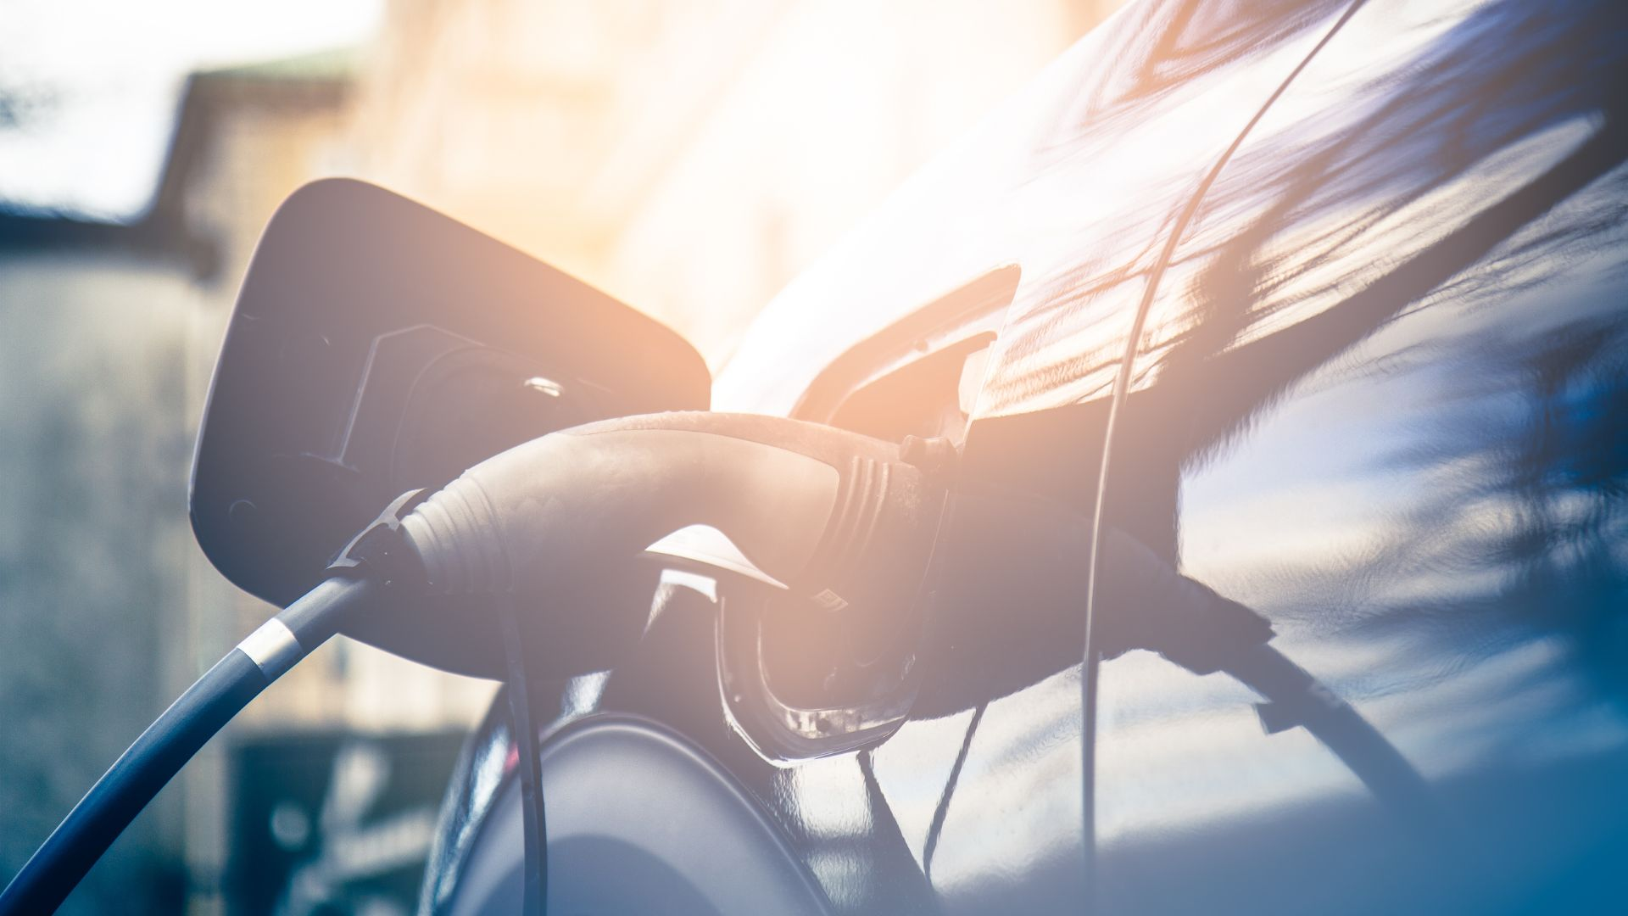
DeeldeZon
project results
Arthur Bennink
Battery on Wheels

Slide 2
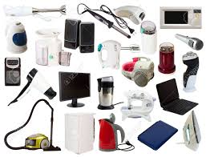
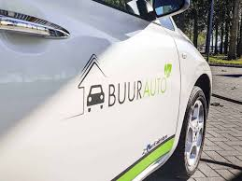
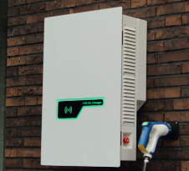
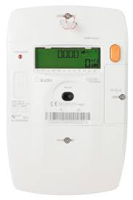
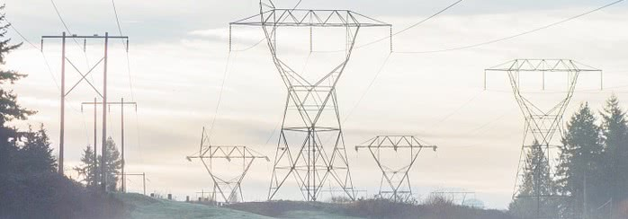
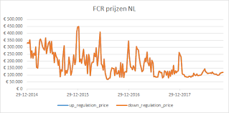
Connecting the dots
Usage (on site)
Electric Vehicle
Charging Station
Building / Grid connection
-Hardware integration
-Asset availability
-AC and/or DC
-Protocol standards
Energy Assets (on site)
OEM (car)
OEM (hardware)
Site owner
Energ. Sup.
Sharing Company
Asset /Site owner
DSO
OEM (hardware)
-Connectivity
-Protocol standards
-Congestion
-Certification
-Connectivity
Grid
Energymarket(s)
CPO backend
Energy Management System
-Dynamic pricing
-Negative sessions
-Connectivity
-Protocol standards
DSO
DSO / TSO
BRP
CPO backend provider
EMS backend provider
TSO
BSP
Energ. Sup.

